Slide 2
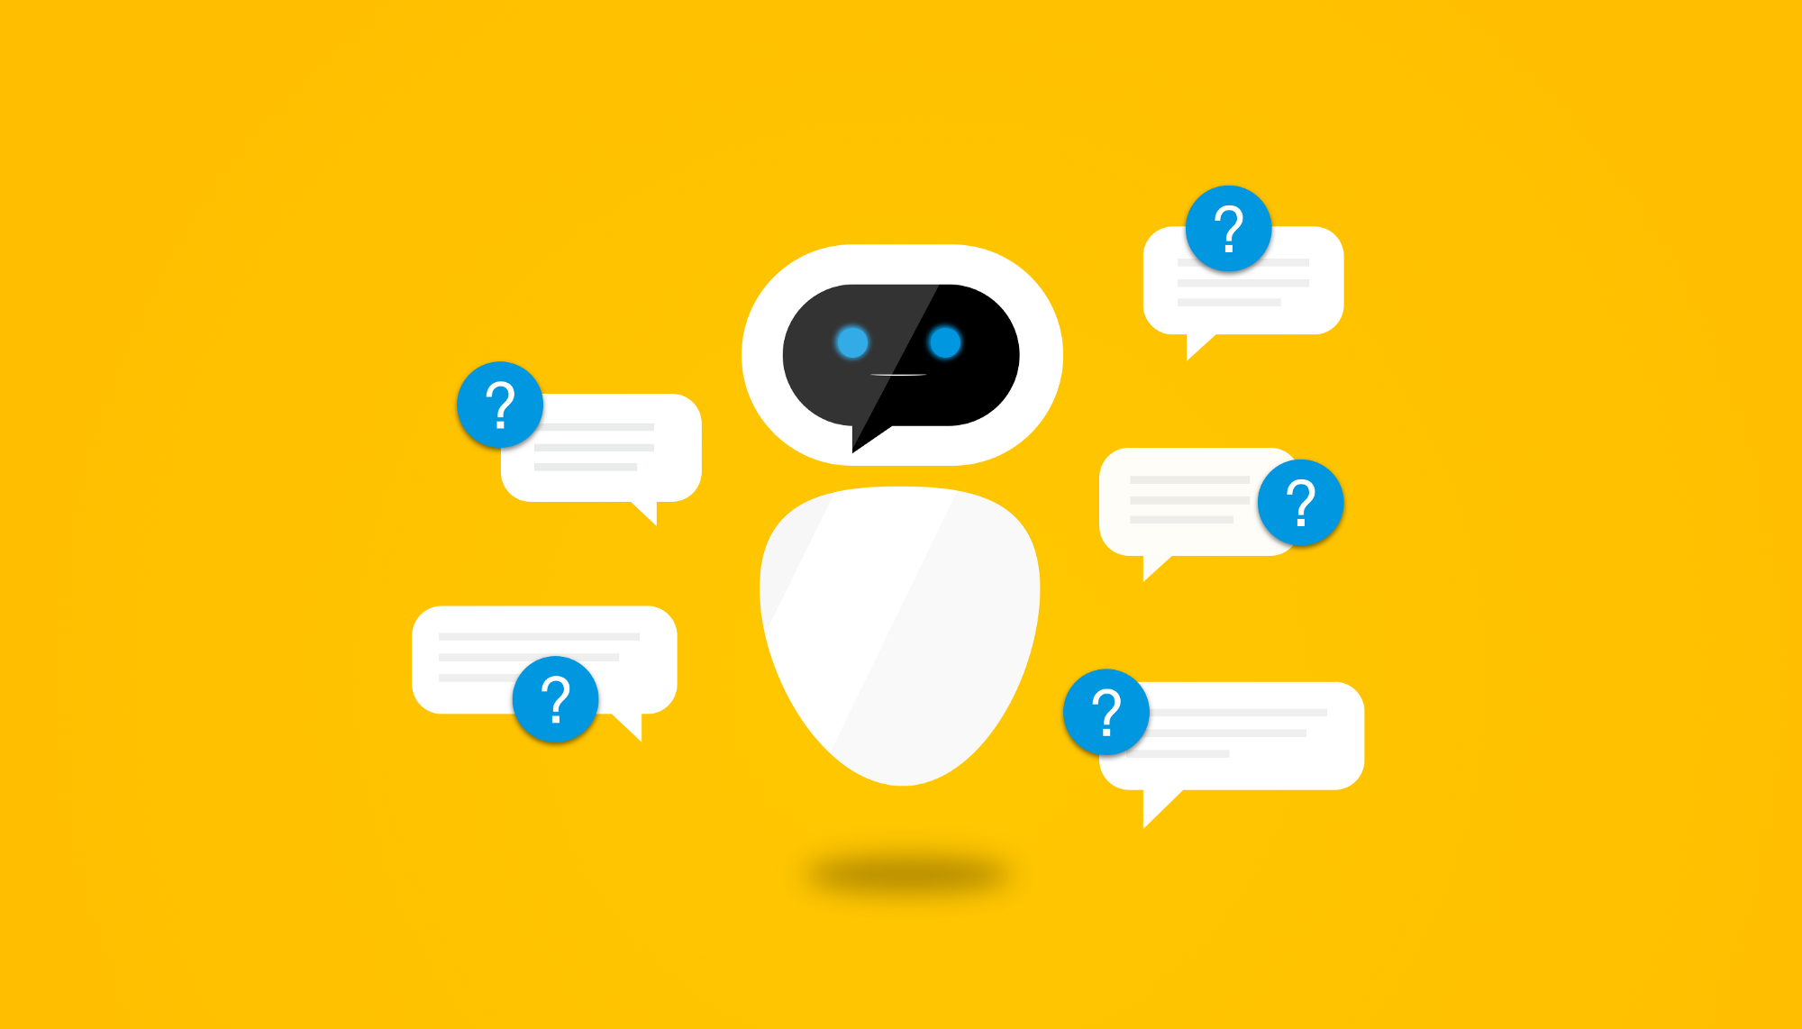
College Governance using Artificial Intelligence
Project By:
Ninad Tongay
Kalpit Vyas
Laxman Reddy
Sarthak Patil
Guide: Ms. Kavita Beldar

Slide 3
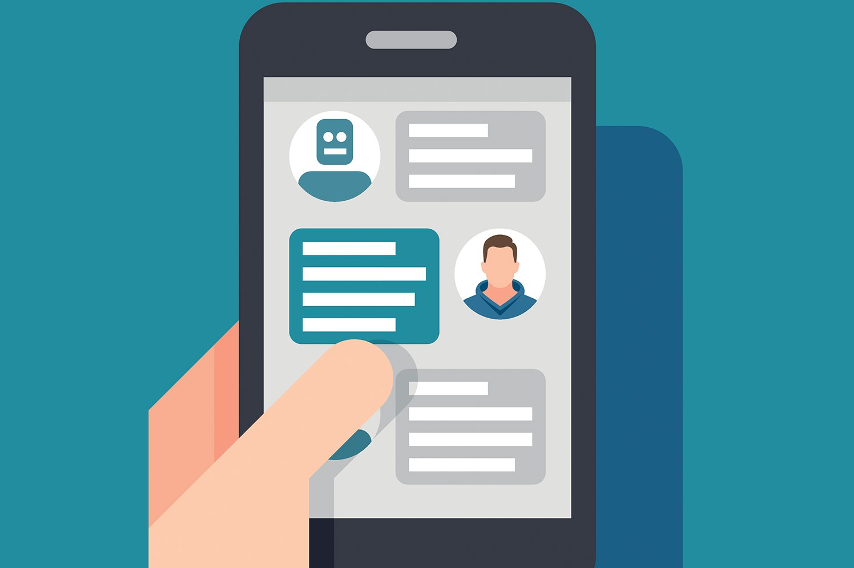
Contents
Introduction
Existing System
Proposed System
System Architecture
System Requirement
Software Requirement
Hardware Requirement
System Design
Advantages
Applications
Conclusion

Slide 4
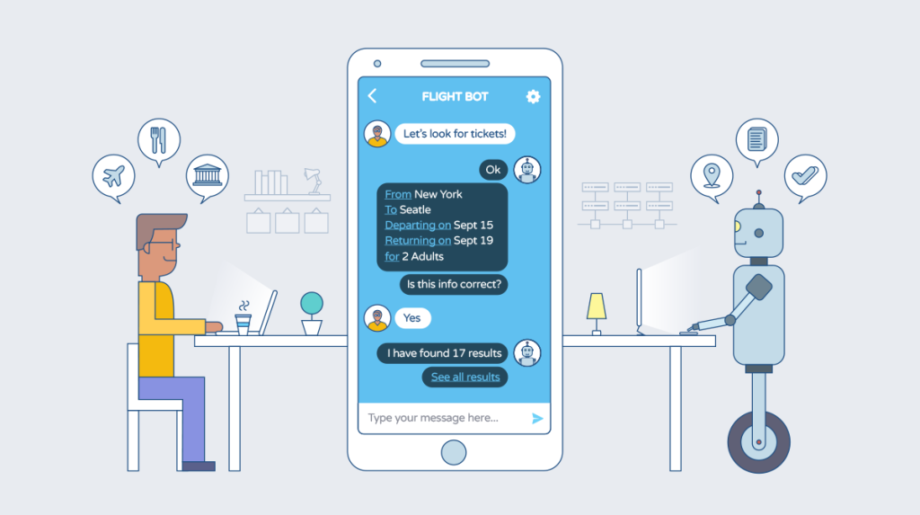
Introduction
Chatbot is a program that simulates a real conversation with users by using artificial intelligence.

Slide 5
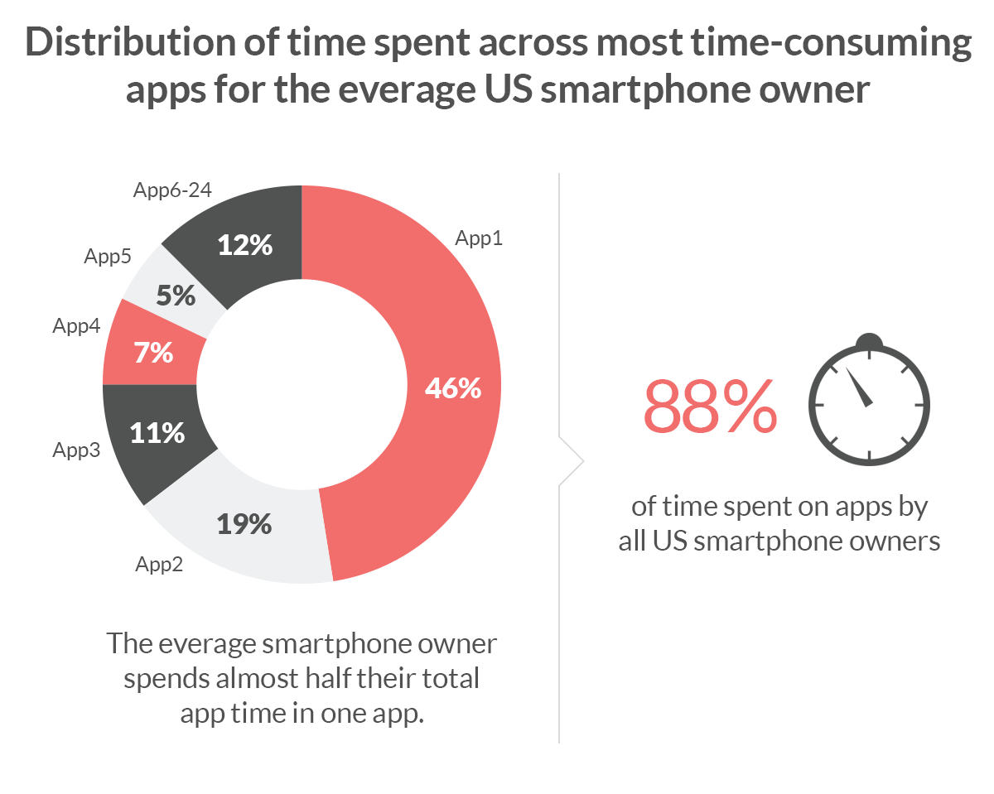
Why are we developing a chatbot and not an Application?
There is one interesting nuance you probably haven't ever realized. In app stores, you can find millions of different apps available.
However, the Forrester Research shows us, that users use about 24 apps per month wherein the 80 percent of the time is on just five apps.
Without any doubt among them are Facebook, WhatsApp, and Snapchat.
Notes:
That means that you hardly can shoot ahead with a new app for your business, but you still have high chances to integrate you chatbot into one of the platforms from your user's everyday routine.

Slide 6
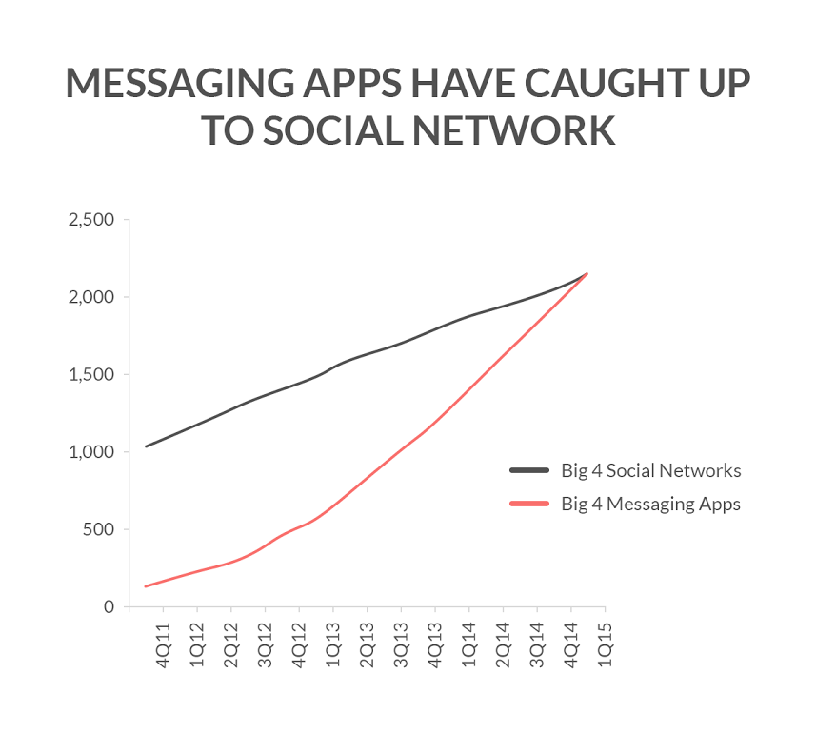

Slide 7
Existing System
Currently chatbot systems are only limited to websites
They cannot use voice as a input
They

Slide 8
Proposed System

Slide 9
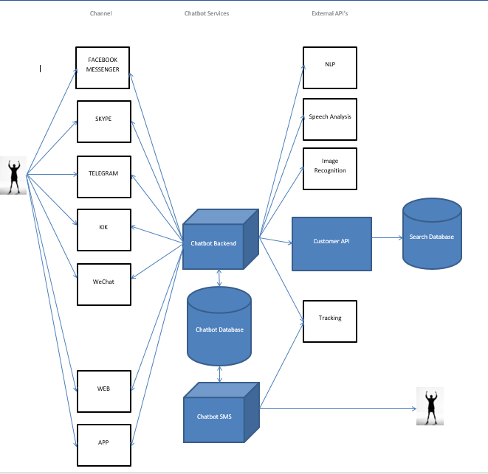
Architecture

Slide 10
Design
Level 0 DFD
User
Ask Queries
Chatbot
Fetch Data
Database
Get Result

Slide 11
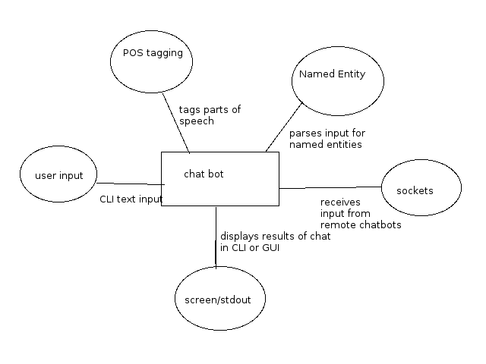
Level 1 DFD

Slide 12

In which situations chatbots are most useful
You receive many requests that are similar to each other
Your customers need information that is easy to provide
You work in a highly competitive niche and many more …..

Slide 13
Advantages
Keeping Up with the Trends: Being Present on Messaging Platforms
Improved Customer Service
Increased Customer Engagement
Easier Approach to Global Markets
Cost Savings
Carry out Specific Tasks
Quick support
Monitoring Consumer Data & Gaining Insights
Better Lead Generation, Qualification and Nurturing
Notes:
a. Extensive Customer Assistance
b. Always-Available Customer Support
c. Proactive Customer Interaction
Easier to use

Slide 14
Applications
Customer Support
News
Weather Report
Search for & Track Flights
Find a Restaurant
Order Food
Personal Assistant

Slide 15
Conclusion
Chatbot is a powerful tool for the brand-to-customer communication that also helps to reduce costs and resources. The reason for such exploding popularity is the rise of mobile messengers and extension technology of artificial intelligence.

